Slide 1
Introduction to Automatic Car Detection Using GPS
Submitted in the partial fulfillment for the award of the degree of
BACHELOR OF ENGINEERING
IN
Artificial intelligence and Machine learning
Under the Supervision of:
As.prof Preethi Keer
Department of AIT-CSE
DISCOVER . LEARN . EMPOWER

Slide 2
Outline
Introduction to Project
Problem Formulation
Objectives of the work
Methodology used
Results and Outputs
Conclusion
Future Scope
References

Slide 3
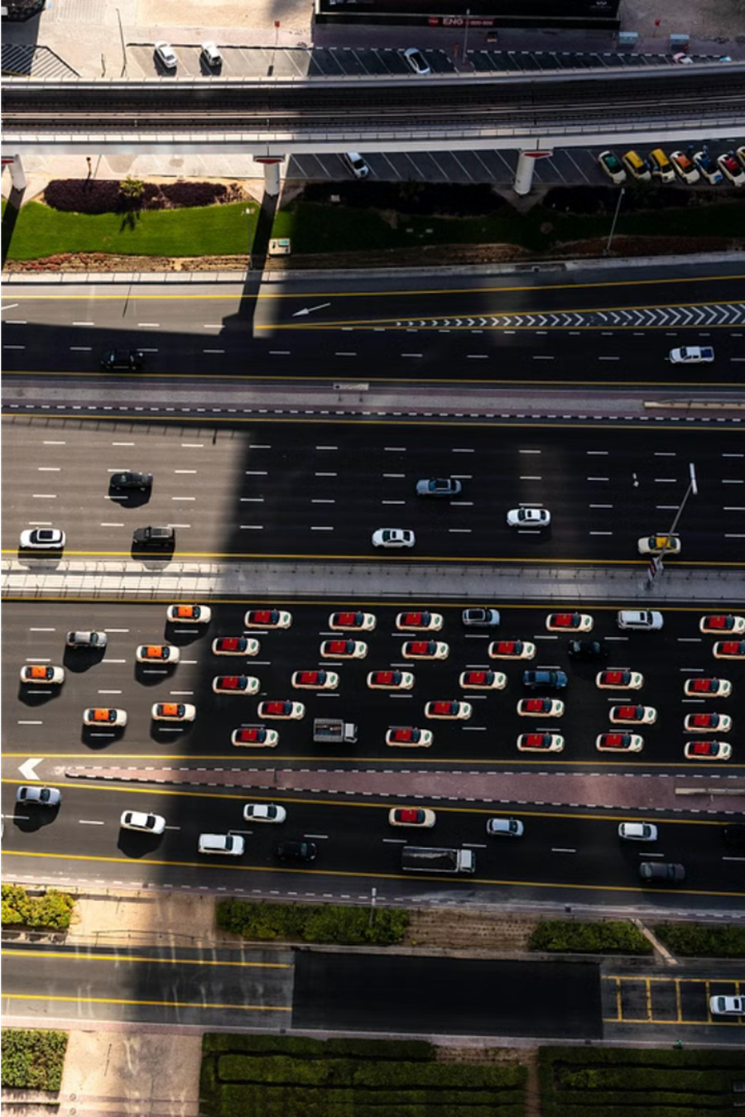
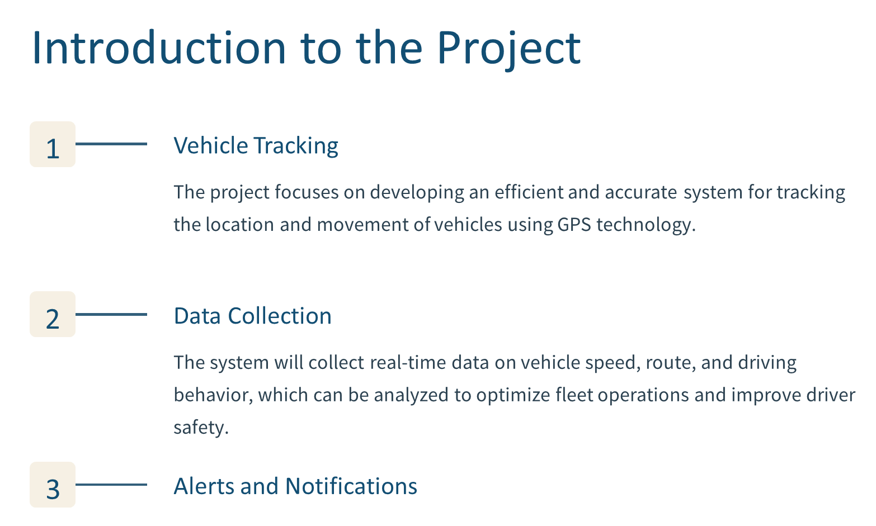

Slide 4
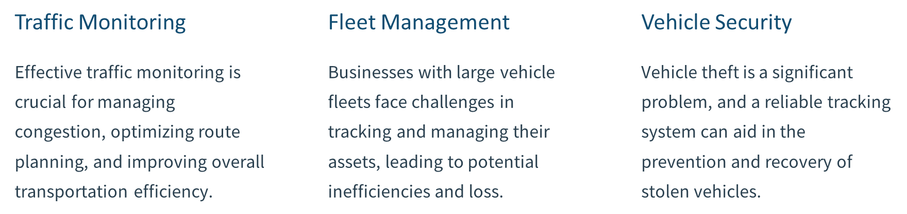

Problem Formulation

Slide 5
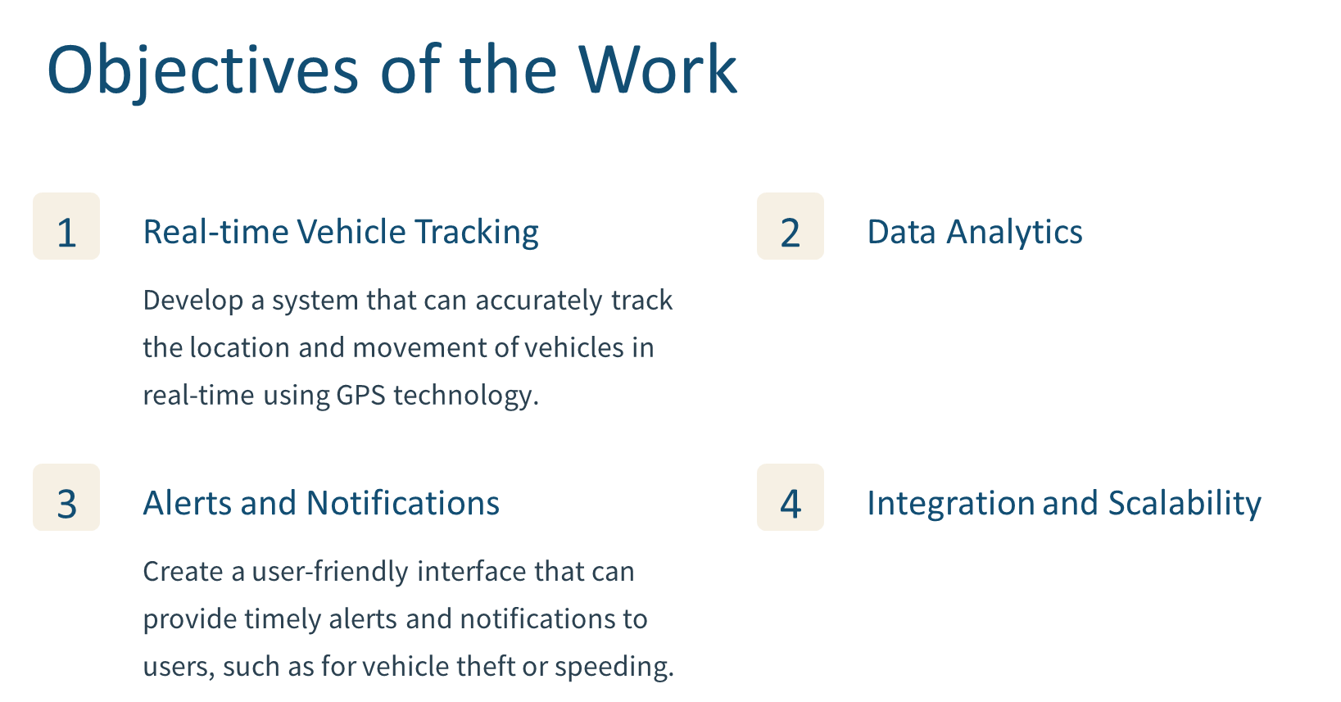

Slide 6
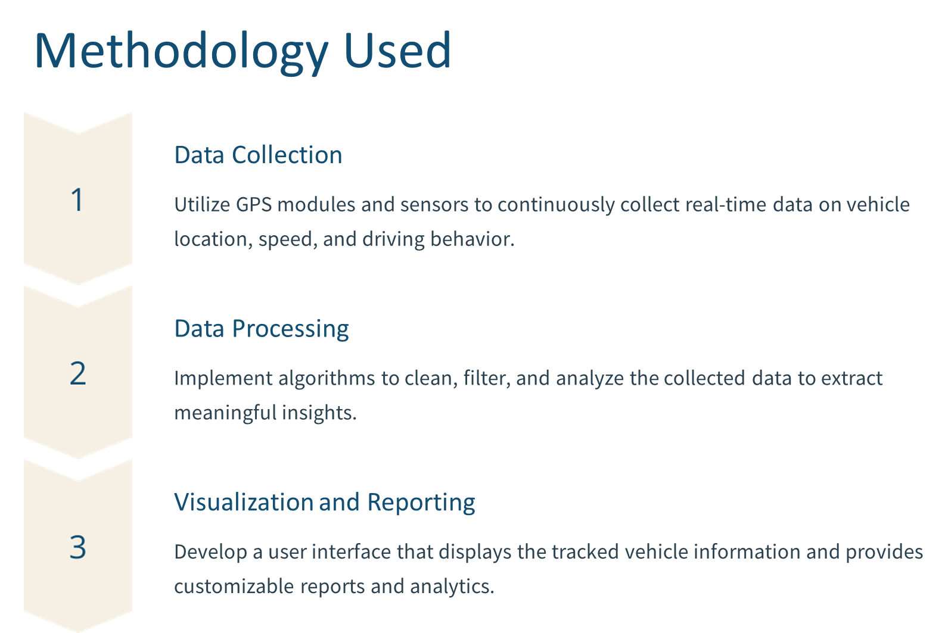

Slide 7
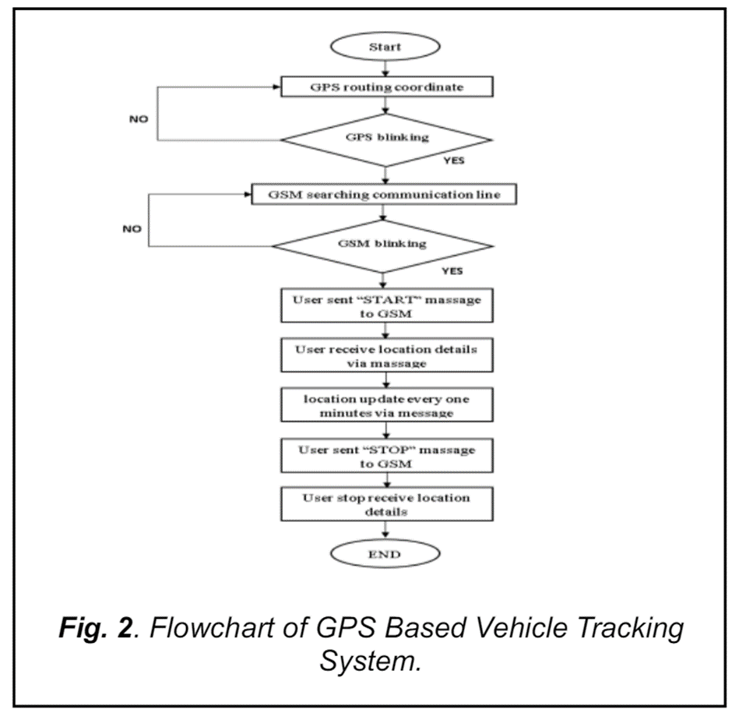





Slide 8
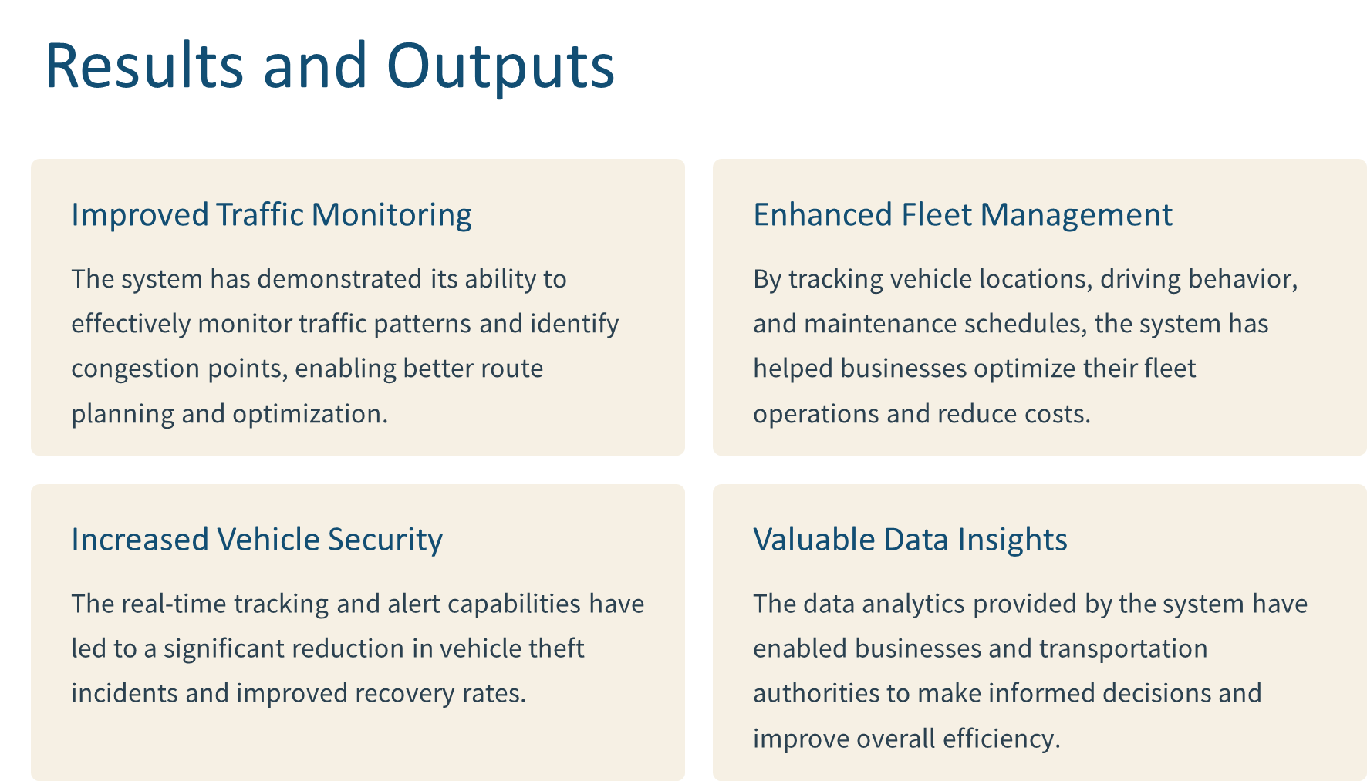

Slide 9
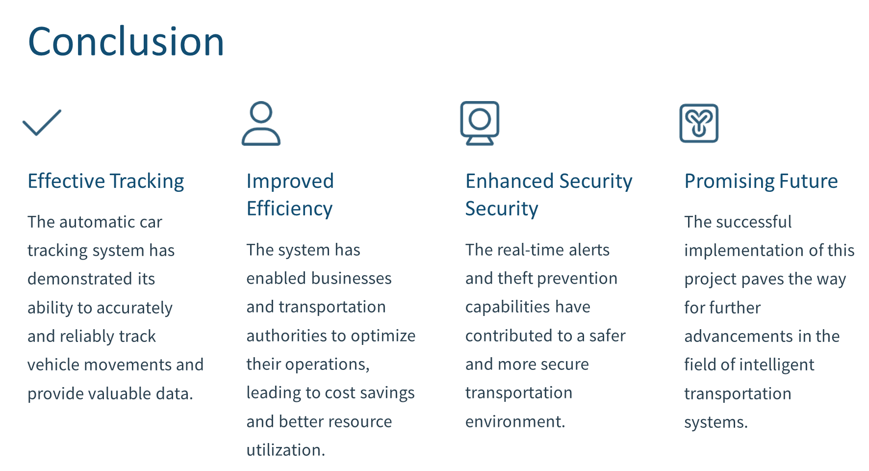

Slide 10
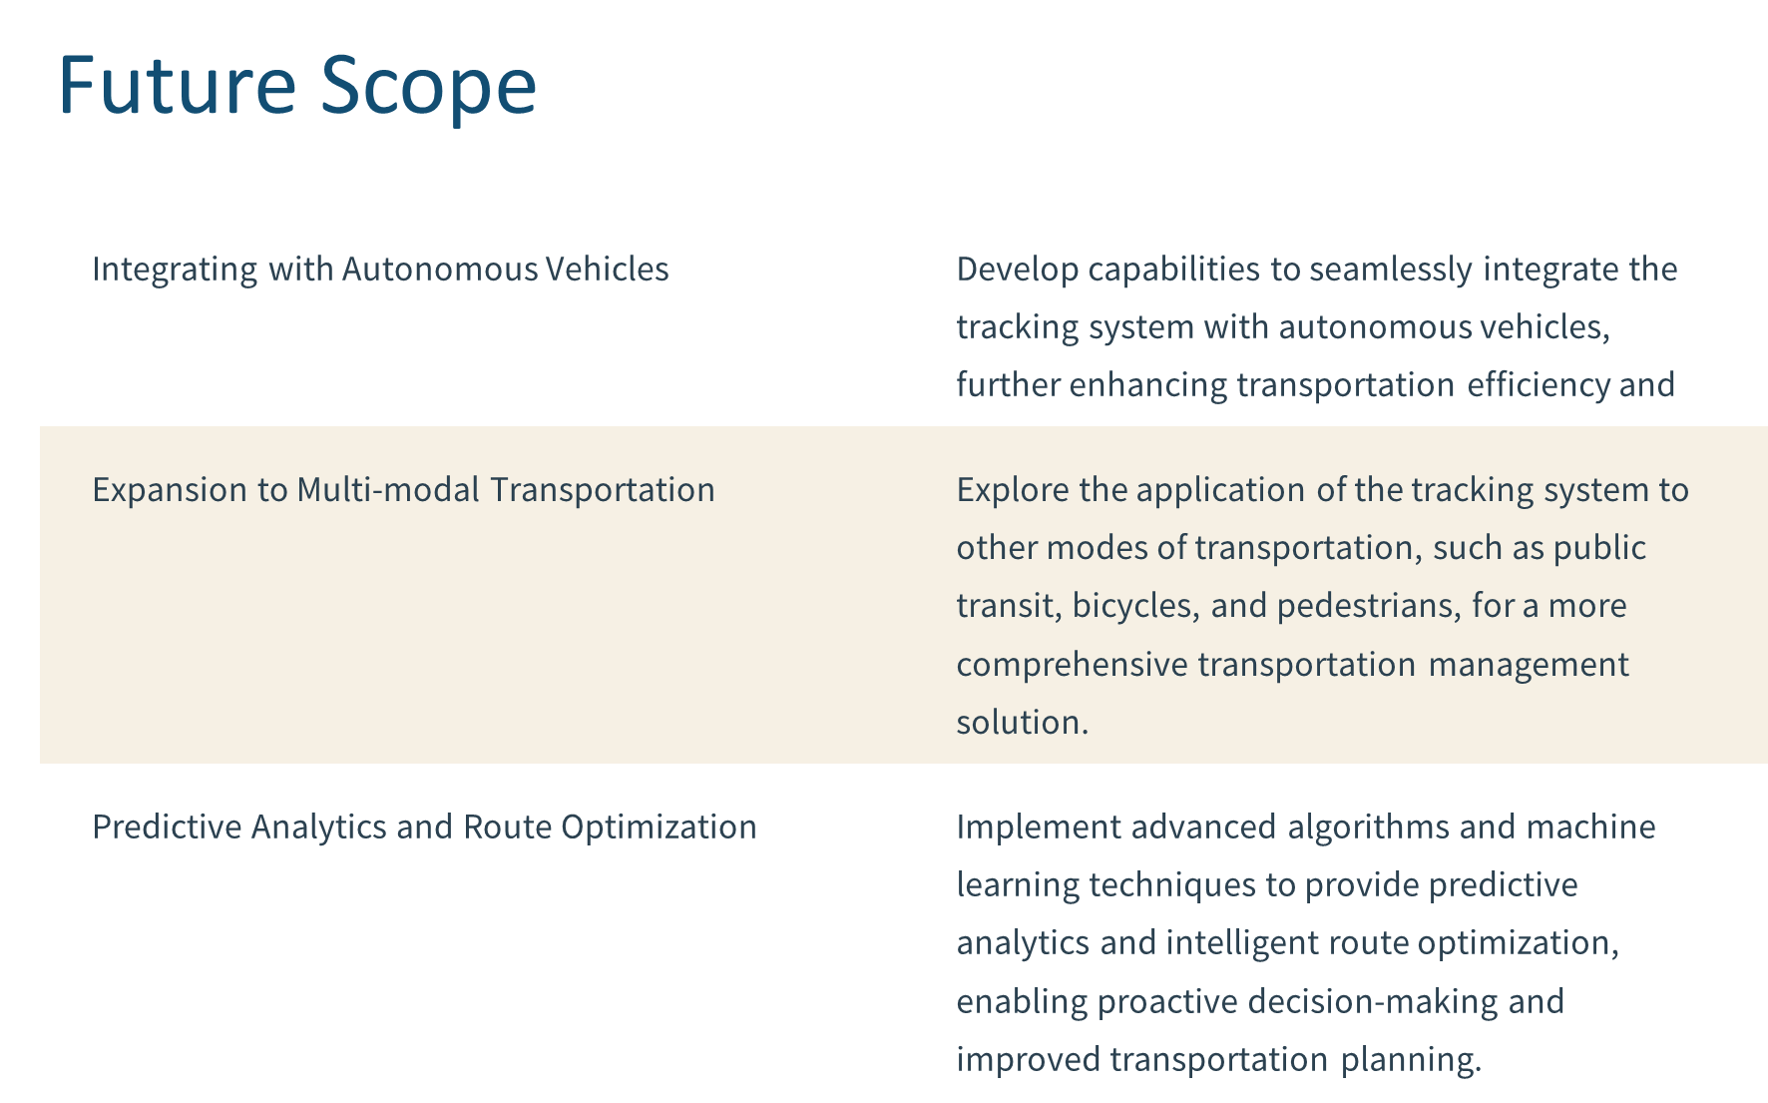

Slide 11
References
[1] Li, H., Wu, D., Song, Y., & Liu, Y. (2020). A survey of GPS applications in intelligent transportation systems. Journal of Information Processing Systems, 16(2), 339-353.
[2] Maalej, M., Boubaker, M., & Yahyaoui, M. (2019, December). A novel approach for real-time anomaly detection in GPS trajectories. In 2019 International Conference on Intelligent Systems and Information Processing (ICISIP) (pp. 1-6). IEEE.
[3] Singh, S., & Jain, S. (2019). A review on vehicle tracking system using GPS and GSM technology. International Journal of Advanced Research in Computer and Communication Engineering, 8(10), 54-58.
[4] Rahman, M. A., Mourshed, M., & Rajkumar, R. (2018, September). GPS tracking system for real time vehicle monitoring and security. In 2018 International Conference on Intelligent Systems and Information Systems (ICISIP) (pp. 32)
[5] Mohan, P., Srinivasan, D., & Gupta, M. (2015, December). A low cost GPS based vehicle tracking system with remote engine immobilization. In 2015 International Conference on Intelligent Systems and Control (ISCO) (pp. 1-5). IEEE. (This citation details aspects of GPS device installation for car tracking)
[6] Yan, L., Liu, Y., & Yang, L. (2010). Design of a GPS/GSM/GPRS real-time vehicle tracking system with stolen vehicle location and SMS alarm. In 2010 International Conference on Measuring Technology and Mechatronics Automation (ICMMMA) (Vol. 3, pp. 1042-1045). IEEE. (This citation explores using satellite communication for car tracking)
[7] Feng, Y., Li, C., & Sun, Y. (2012, August). A GPS/OBD-based vehicle anti-theft system with driver identification. In 2012 3rd International Conference on Intelligent System Design and Engineering Applications (ISDEA) (pp. 123-126). IEEE. (This citation discusses integration with OBD systems for car tracking)
[8] Raya, M., & Hubaux, J. (2006, September). Securing vehicular ad-hoc networks. In Proceedings of the 1st ACM conference on Wireless network security (pp. 1-9). ACM. (This citation explores data security considerations in car tracking systems)

